Slide 1
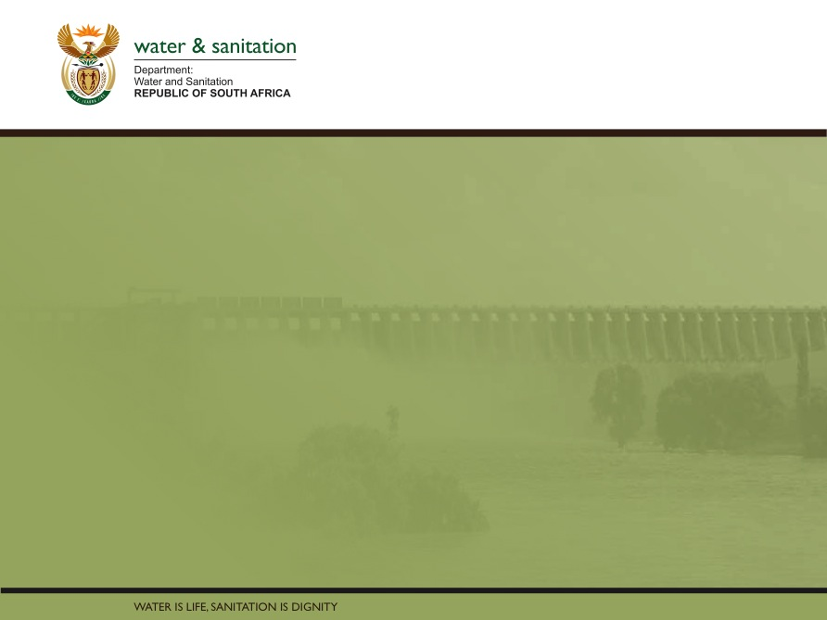
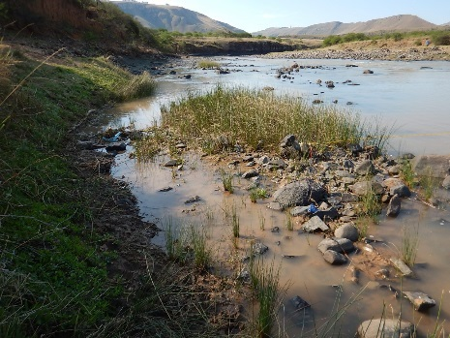
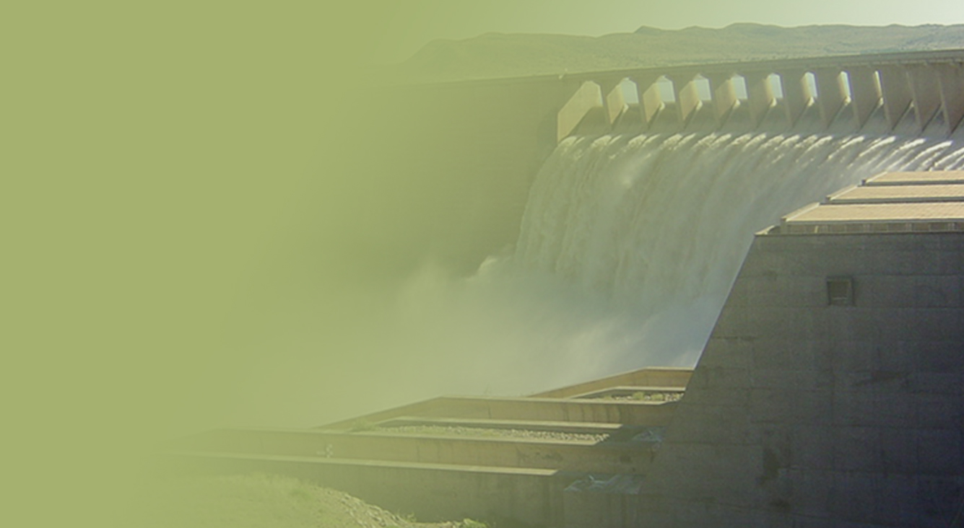
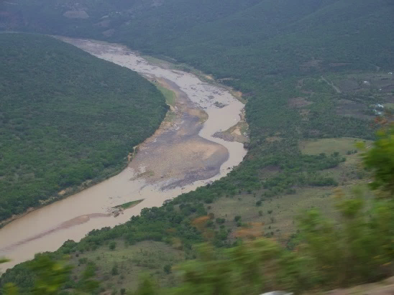
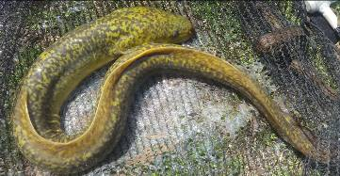
PSC MEETING 4,
15 MAY 2018
PRESENTATION TITLE
Presented by:
Name Surname
Directorate
Date
DETERMINATION OF WATER RESOURCE CLASSES AND RESOURCE QUALITY OBJECTIVES FOR THE WATER RESOURCES IN THE MZIMVUBU CATCHMENT:
WETLANDS
James MacKenzie

Slide 2
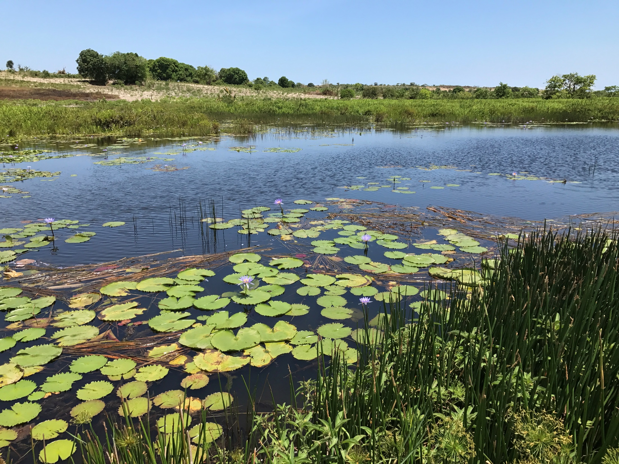
WETLAND STUDY:
INCLUDING RQOs
Summary Wetland PES, EIS
Summary Wetland Priority
Wetland RQOs
    Broad Level RQOs
    Catchment Level RQOs
    Detailed RQOs

Slide 3
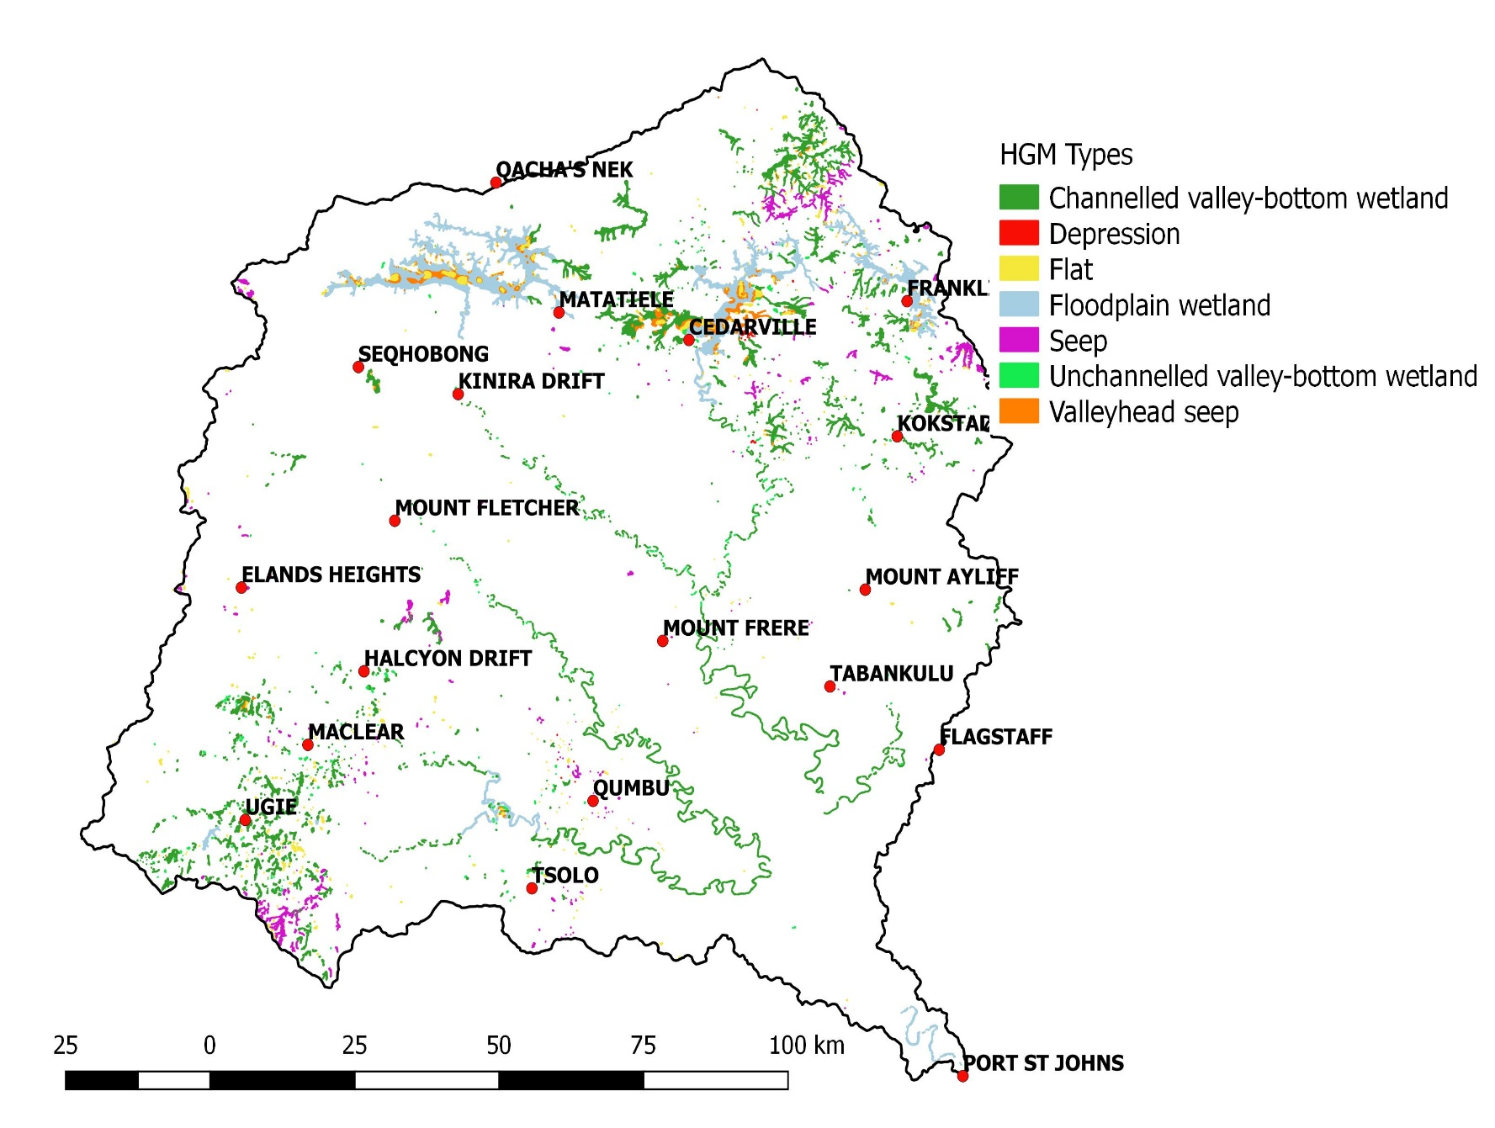
WETLAND TYPES

Slide 4
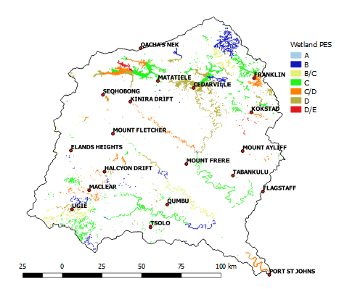
SUMMARY: WETLAND PES

Slide 5
SUMMARY: WETLAND EI, ES AND PRIORITY (EXAMPLE)
SQ | Name of main river in SQ | Wetland EI | Wetland ES | SCI | IIS | PES | IEI | WRUI | PRIORITY
T31A-04712 | Mzimvubu | HIGH | LOW | MODERATE | HIGH | C | 3 | 1 | 2
T31B-04745 | Krom | HIGH | MODERATE | LOW | HIGH | B | 5 | 2 | 3
T31B-04868 | Krom | VERY HIGH | MODERATE | LOW | VERY HIGH | B | 5 | 1 | 2
T31B-04873 | unnamed | VERY HIGH | MODERATE | LOW | VERY HIGH | B | 5 | 2 | 3
T31C-04796 | Mngeni | HIGH | MODERATE | HIGH | HIGH | C | 3 | 2 | 2
T31C-04866 | Mzimvubu | MODERATE | MODERATE | MODERATE | MODERATE | B/C | 3 | 1 | 2
T31C-04879 | Nyongo | MODERATE | VERY HIGH | HIGH | VERY HIGH | C | 5 | 2 | 3
T31D-04926 | Mzimvubu | HIGH | MODERATE | LOW | HIGH | C | 3 | 1 | 2
T31D-04936 | Riet | VERY HIGH | MODERATE | LOW | VERY HIGH | B/C | 5 | 2 | 3
T31D-05030 | Riet | HIGH | LOW | LOW | HIGH | C | 3 | 2 | 2
T31D-05060 | unnamed | HIGH | MODERATE | MODERATE | HIGH | D | 3 | 1 | 2
T31D-05076 | Mzimvubu | VERY HIGH | VERY LOW | LOW | VERY HIGH | C | 5 | 2 | 3
T31E-04836 | Tswereka | HIGH | MODERATE | HIGH | HIGH | B | 5 | 1 | 2
T31E-04910 | Malithasana | HIGH | MODERATE | HIGH | HIGH | D | 3 | 1 | 2

Slide 6
SUMMARY: HIGHEST PRIORITY
WETLANDS
The prioritization process determined which wetlands became the focus of more detailed assessments including:
  PES, EIS validation
  EWR
  RQO (detailed)

Slide 7
SUMMARY: HIGHEST PRIORITY WETLANDS

Slide 8
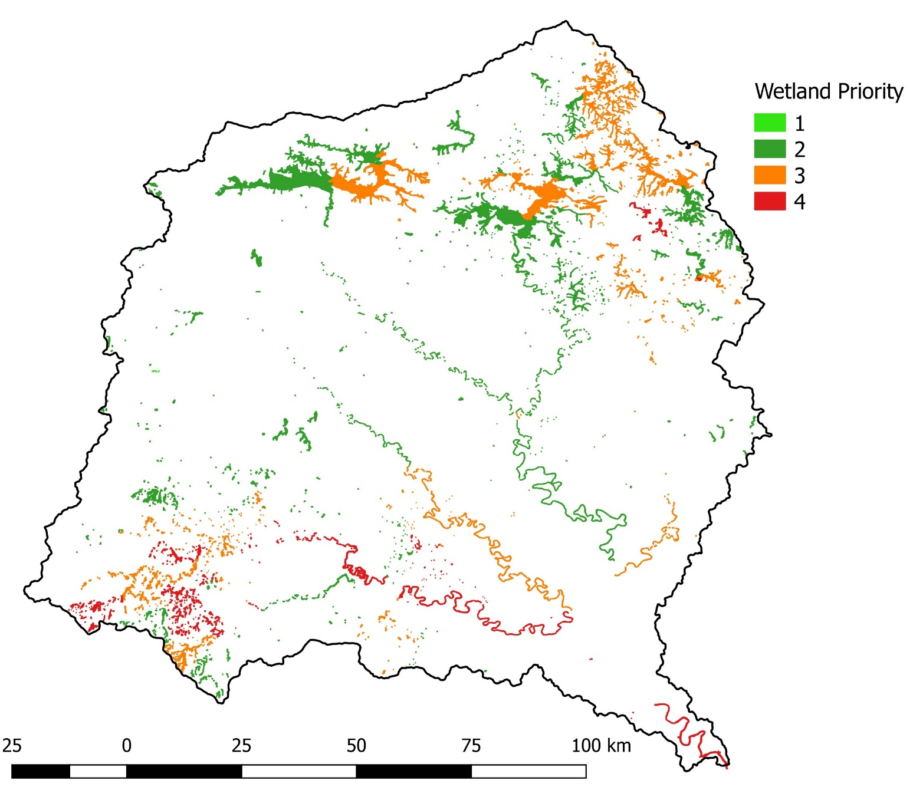
SUMMARY: HIGHEST PRIORITY WETLANDS

Slide 9
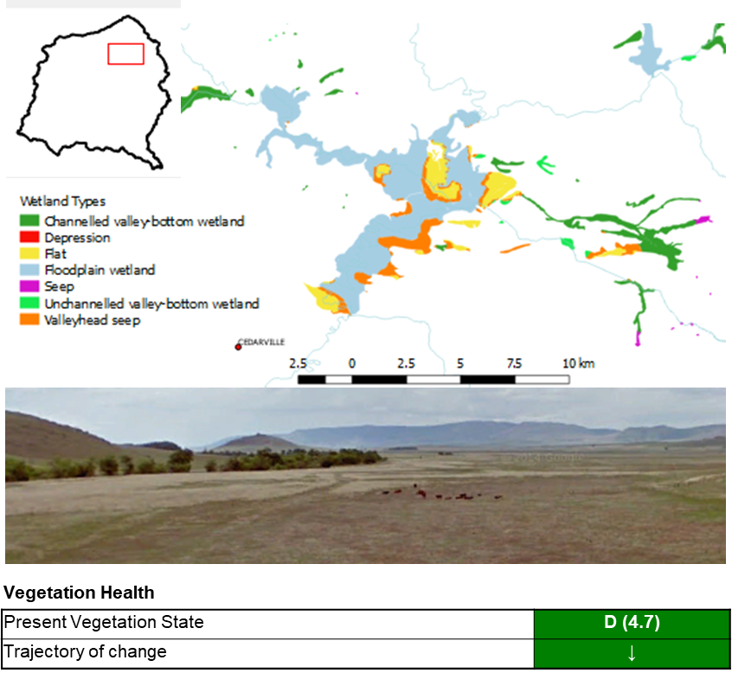

SUMMARY: DETAILED PES, EXAMPLE OF A HIGH PRIORITY WETLAND COMPLEX
Mzimvubu Floodplains

Slide 10
SUMMARY: DETAILED PES, EXAMPLE OF A HIGH PRIORITY
WETLAND COMPLEX
Disturbance Class | Extent (%) of HGM |  |  | Total Extent (%)
 | Floodplain 1 | Floodplain 2 | Floodplain 3 | Wetland Complex
Infrastructure | 3 | 3 | 2 | 2.6
Shallow flooding by dams | 3 | 5 | 15 | 8.4
Agricultural activities / Crop lands | 15 | 25 | 25 | 20.9
Perennial pastures | 15 | 15 | 15 | 15.0
Canals / trenching /furrows | 2 | 2 | 2 | 2.0
Old / abandoned lands | 5 | 5 | 10 | 7.1
Dense alien vegetation patches. | 3 | 3 | 3 | 3.0

Slide 11
RQOs: THREE LEVELS OF RQOs FOR THE WMA
Broad level narrative RQOs
  quaternary catchment scale
  focused on averages of PES and EIS categories (existing data)
  have been developed so that at the least all wetlands, even low priority, have some measure of protection
Catchment level RQOs
  SQ catchment scale
  specify more detail and at a finer scale than the broad level RQOs
  component (e.g. habitat) and sub-component (e.g. integrity and condition) specific
Detailed RQOs
  Wetland or wetland complex scale
  Google Earth © used to conduct level 1 Wet-Health assessments for floodplains and verify PESEIS metrics for other wetland types
  Based on wetland habitat modification and wetland continuity (fragmentation and connectivity) modification

Slide 12
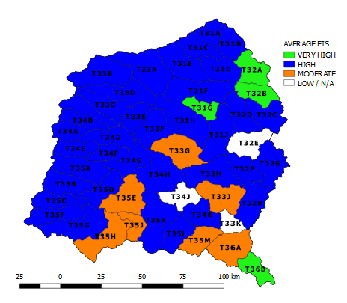
BROAD LEVEL NARRATIVE RQOs FOR THE WMA

Slide 13
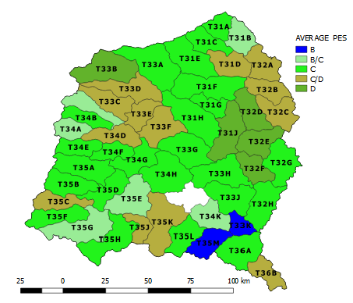
BROAD LEVEL NARRATIVE RQOs FOR THE WMA

Slide 14
CATCHMENT LEVEL RQOs
QUAT | SQR PESEIS | NAME | Wetland EI | Wetland ES | EIS | PES | WETLAND PRIORITY
T31J | T31J-05588 | Mzimvubu | HIGH | MODERATE | HIGH | D | 2
T32A | T32A-04907 | Mzintlanga | VERY HIGH | MODERATE | VERY HIGH | D | 3
T32A | T32A-04965 | Mzintlava | VERY HIGH | MODERATE | VERY HIGH | C | 3
T32B | T32B-05103 | Mzintlava | VERY HIGH | MODERATE | VERY HIGH | C/D | 2
T32B | T32B-05116 |  | VERY HIGH | HIGH | VERY HIGH | C | 4
T32B | T32B-05184 | Mzintlava | VERY HIGH | MODERATE | VERY HIGH | D | 2
T32C | T32C-05219 | Mill Stream | HIGH | MODERATE | HIGH | C | 2
T32C | T32C-05243 | aManzamnyama | VERY HIGH | MODERATE | VERY HIGH | D | 3
T32C | T32C-05273 | Mzintlava | HIGH | HIGH | HIGH | D | 3
T32C | T32C-05313 | Mzintlava | HIGH | MODERATE | HIGH | B/C | 4
RQOs (mostly narrative) set for the following components:
  Water quantity
  Water quality
  Habitat
  Biota
  Ecosystem services

Slide 15
CATCHMENT LEVEL RQOs

Slide 16
CATCHMENT LEVEL RQOs

Slide 17
CATCHMENT LEVEL RQOs

Slide 18
CATCHMENT LEVEL RQOs

Slide 19
CATCHMENT LEVEL RQOs

Slide 20
DETAILED RQOs

Slide 21
DETAILED RQOs

Slide 22
DETAILED RQOs

Slide 23
DETAILED RQOs

Slide 24
QUESTIONS FOR CLARIFICATION

